Slide 1
UNIT 5
MULTIMODAL BIOMETRICS AND PERFORMANCE MEASURES

Slide 2
Introduction to Multimodal Biometrics
Multimodal biometrics is an automated personal identification system that uses a combination of two or more distinct biometric traits to determine or verify an individual's identity.
This approach was developed to address the limitations of traditional unimodal biometric systems, which rely on a single characteristic (like a single fingerprint) and may be vulnerable to performance issues, environmental factors, or spoofing.
Common Biometric Modalities
Physiological Traits: Fingerprint, Face, Iris, Retina, Palmprint, Finger Vein, DNA.
Behavioral Traits: Voice (which has physiological and behavioral aspects), Signature, Gait (walking pattern), Keystroke dynamics

Slide 3
Working of Multimodal Biometric System
Capturing module
Feature extraction module
Comparison module
Decision making module

Slide 4
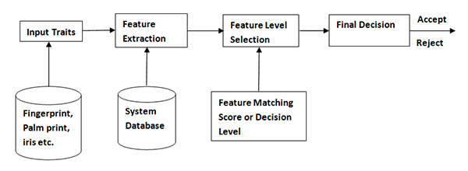
Block diagram of Multimodal Systems

Slide 5
Types of multimodal biometric systems
The various types of multimodal biometric systems are discussed below:
Multi-algorithmic biometric systems
These systems take a single biometric sample from a single sensor and then process it using two or more different algorithms.
Multi-instance biometric systems
These systems use one or more sensors to capture samples of two or more different samples of the same biometric trait. An example of this could be a system capturing images of multiple fingers.
Multi-sensorial biometric systems
These systems use two or more distinctly different sensors to capture the same instance of a biometric trait.

Slide 6
Biometric Fusion
Fusion Scenarios
Single biometric trait, multiple sensors.
Single biometric trait, multiple classifiers (say, minutiae-based matcher and texture-based matcher).
Single biometric trait, multiple units (say, multiple fingers).
Multiple biometric traits of an individual (say, iris, fingerprint, etc.).

Slide 7
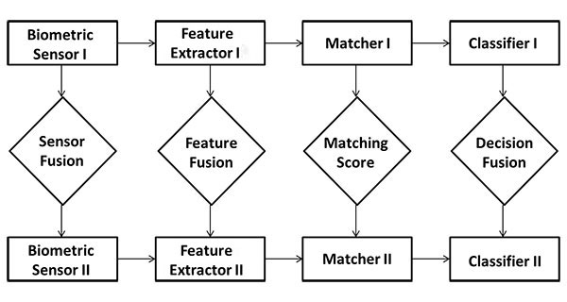

Slide 8
Fusion in multimodal biometric systems
Sensor level fusion
In sensor level fusion, we fuse the biometric traits coming from different sensors such as fingerprint scanner, iris scanner, video camera etc. to form a merged biometric trait and process.
Feature level fusion
In feature level fusion, signals coming from different biometric channels are first processed after which the feature vectors are extracted separately from each biometric trait.
Matching score level fusion
In this fusion level, the feature vectors are processed separately rather than combining them. Then an individual matching score is found and based on the accuracy of each biometric channel, we then fuse the matching level to find a composite matching score which will be used for classification
Decision level fusion
In decision level fusion, each biometric trait is first pre-classified separately. The individual biometric trait is first captured and then features are extracted from the captured trait.

Slide 9
Two Factor Authentication
Two-Factor Authentication (2FA) with biometrics requires users to provide two distinct pieces of evidence to prove their identity, combining
"something they know" (like a password) with
"something they are" (their unique physical or behavioral traits)
Two-factor authentication (2FA) –– also known as multi-factor authentication (MFA)
Biometric 2FA Working
First Factor (Something You Know):
The user typically provides a password or PIN to access an account or system.
Second Factor (Something You Are):
The system then prompts the user for a biometric verification, such as a fingerprint scan, facial recognition, or voice command.
Verification:
The system compares the submitted biometric data with the pre-registered biometric template, and if both factors match, access is granted.

Slide 10
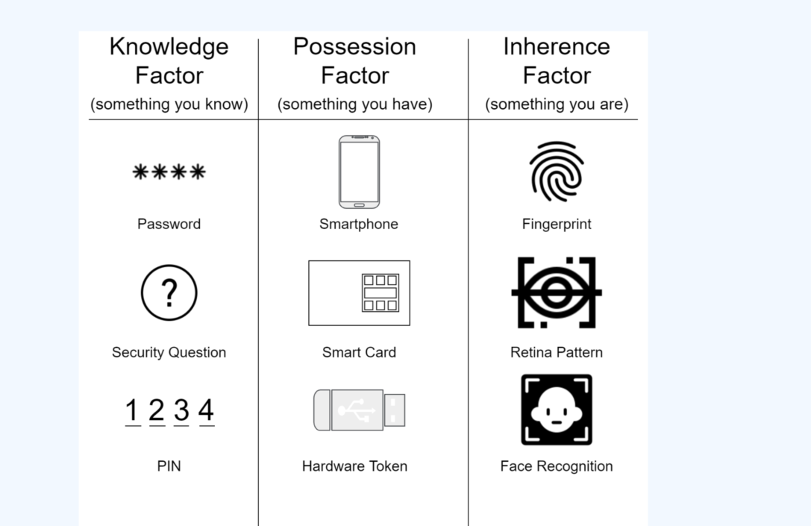

Slide 11
TWO FACTOR AUTHENTICATION - NORMALIZATION IN BIOMETRICS

Slide 12
Statistical measures of biometrics
Statistical measures of biometrics include
False Acceptance Rate (FAR) (imposters are incorrectly accepted),
False Rejection Rate (FRR) (legitimate users are incorrectly rejected),
Failure to Enroll Rate (FTE) (users cannot successfully enroll), and
Equal Error Rate (EER) (the point where FAR and FRR are equal).
A lower FAR and FRR indicate a more secure and user-friendly system, respectively, while a lower EER shows a more accurate biometric system overall.

Slide 13
FAR (False Acceptance Rate)
Definition:
The probability that a biometric system incorrectly identifies an unauthorized person (imposter) as a genuine user.
Implication:
A high FAR means the system is not secure, as it allows unauthorized access.
Example:
A facial recognition system incorrectly identifying a stranger as a registered user.

Slide 14
FRR (False Rejection Rate)
Definition:
The probability that a biometric system incorrectly rejects a legitimate user.
Implication:
A high FRR leads to a poor user experience, as it frequently denies access to authorized individuals.
Example:
A fingerprint system failing to recognize a registered user's fingerprint due to factors like dirt or improper placement.

Slide 15
FTE (Failure to Enroll Rate)
Definition:
The percentage of users who are unable to successfully register their biometric data with the system.
Implication:
High FTE can indicate issues with the biometric template quality, scanning device, or the system's ability to handle certain types of biometric data.

Slide 16
EER (Equal Error Rate)
Definition:
The point at which the False Acceptance Rate (FAR) and the False Rejection Rate (FRR) are equal.
Implication:
A lower EER indicates a more accurate biometric system and is a common metric for comparing different systems.
Relationship:
EER represents the crossover point where the system's sensitivity is balanced between security (minimizing unauthorized access) and usability (minimizing rejection of legitimate users)

Slide 17
